Slide 1
Can We Trust The Bible?

Slide 2
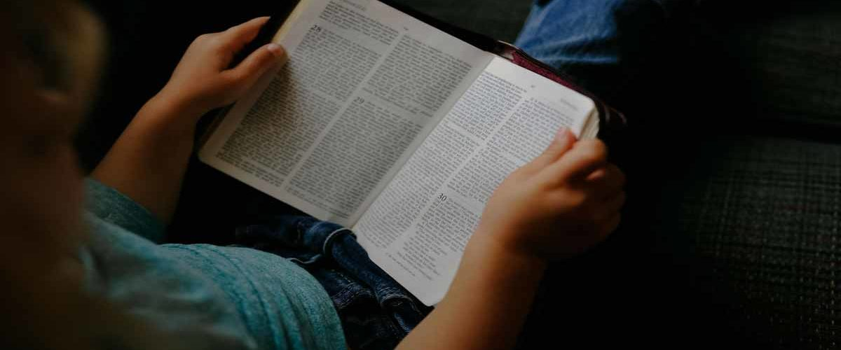
What do you know about the Bible?

Slide 3
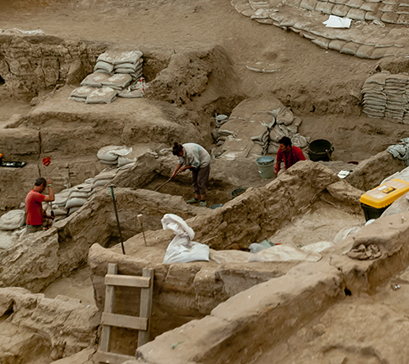
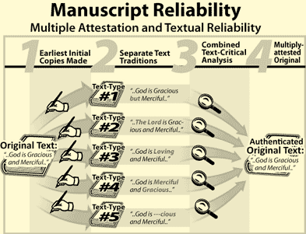
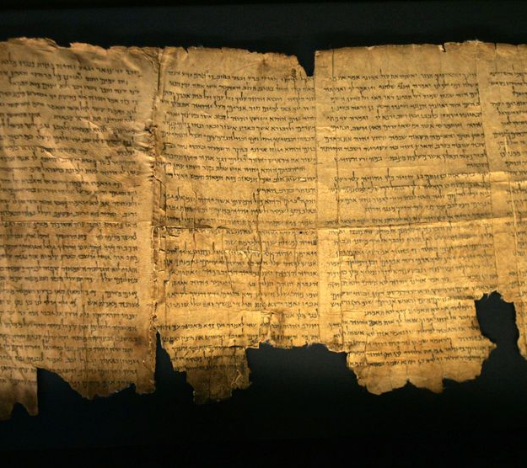
3 Tests for Authenticity
Bibliographical
Internal Evidence
External Evidence

Slide 4
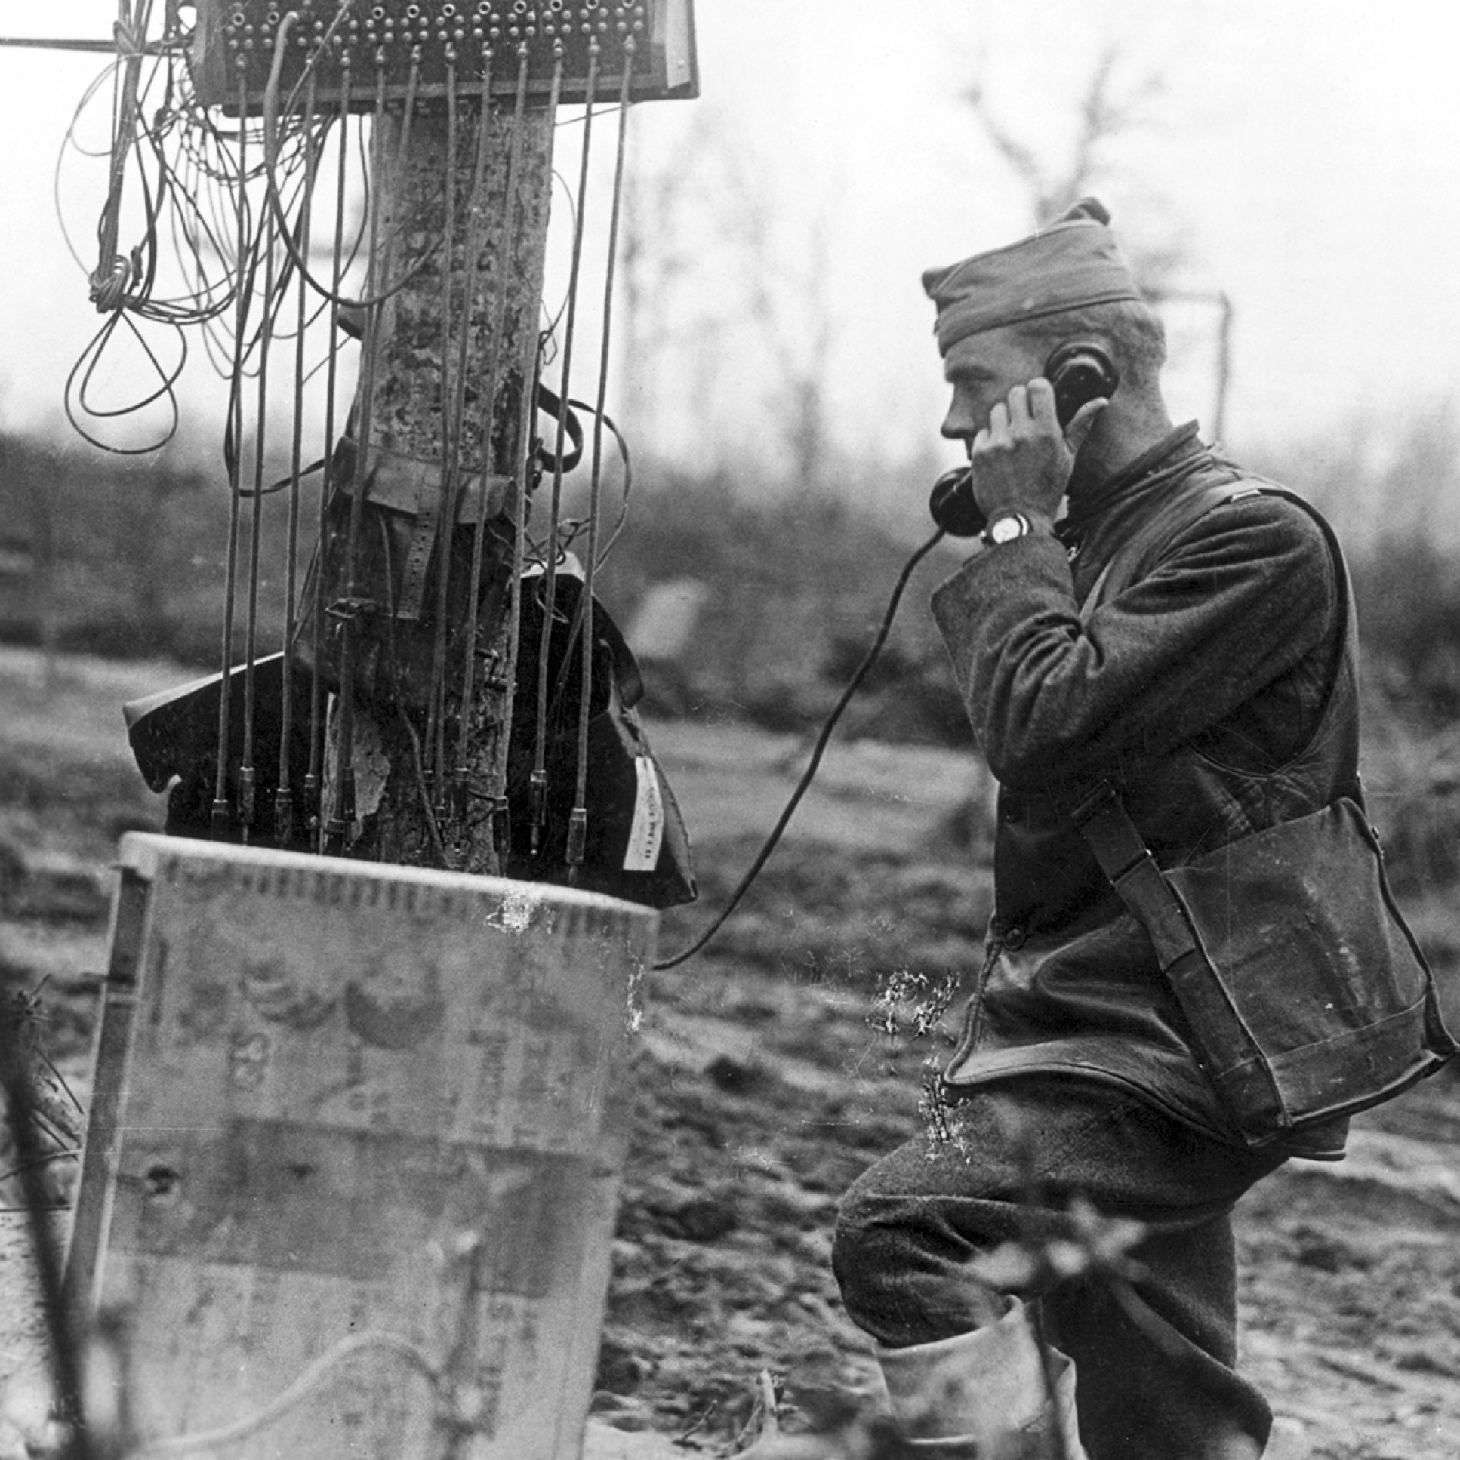
Telephone Game

Slide 5
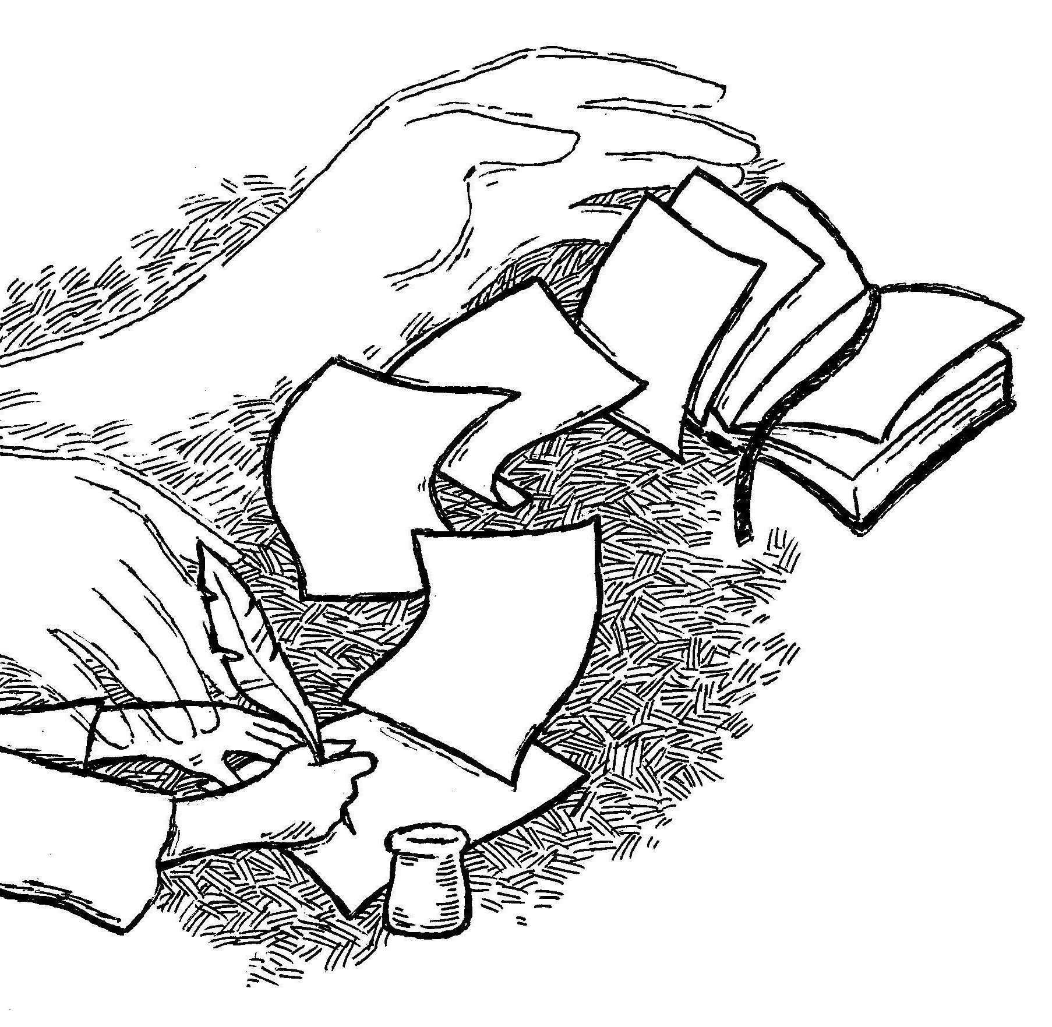
2 Peter 1:21

Slide 6
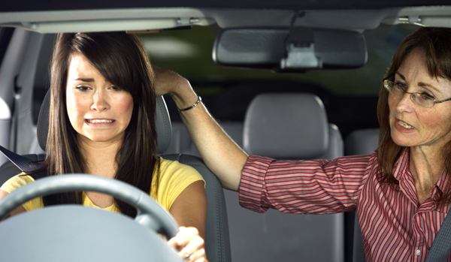
2 Timothy 3:16-17
Teaching
Training
Correcting
Rebuking

Slide 7
Remember This
Three primary tests prove the authenticity of the Bible: bibliographical, internal evidence, and external evidence.
The Bible is like a user’s manual for our life. It teaches us the way to go. It teaches, trains, corrects, and rebukes so we can walk with God.
We also need experts to teach us and train us, so we can use the Bible well.

Slide 8
Why not read the Bible?

Slide 9
Memorize
2 Timothy 3:16-17
“All Scripture is God-breathed and is useful for teaching, rebuking, correcting and training in righteousness, so that the servant of God may be thoroughly equipped for every good work.”

